Slide 1
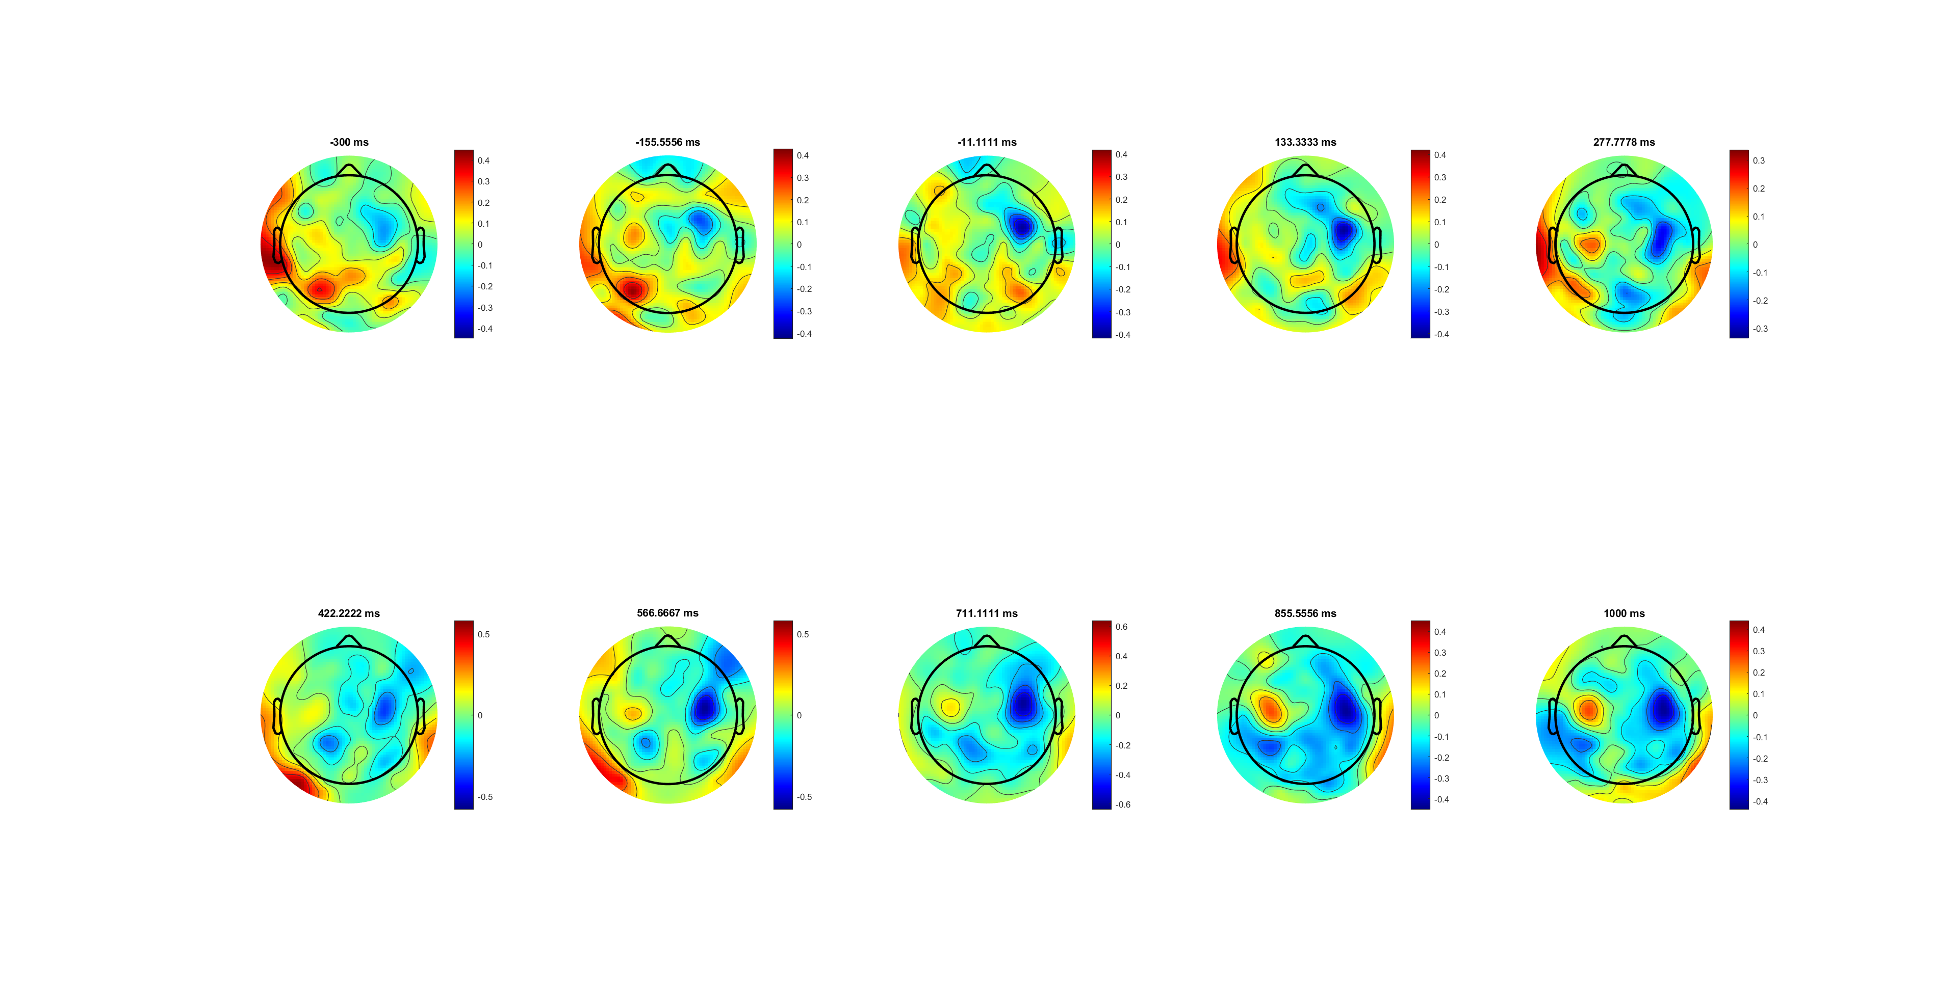
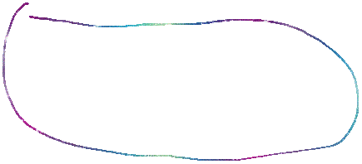
H12 data (SL -300 1000) left-right

Slide 2
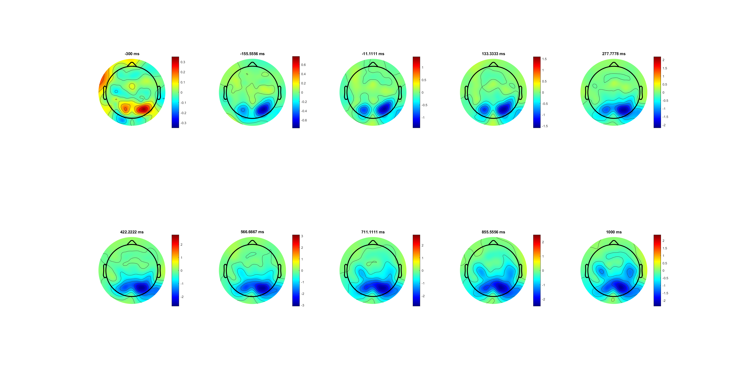
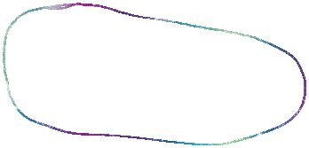
Left only

Slide 3
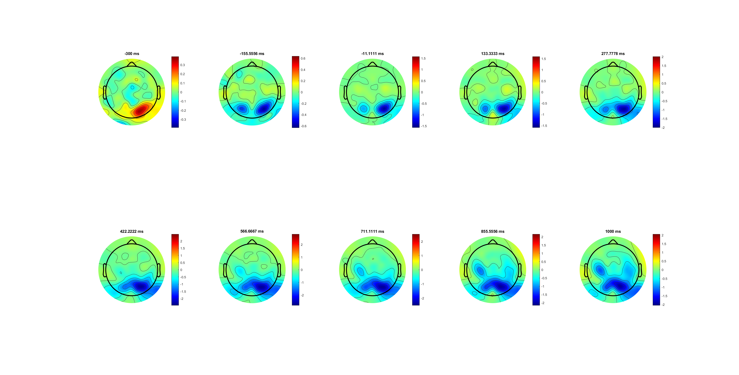
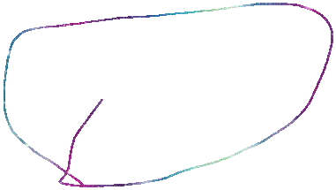
Right only

Slide 4
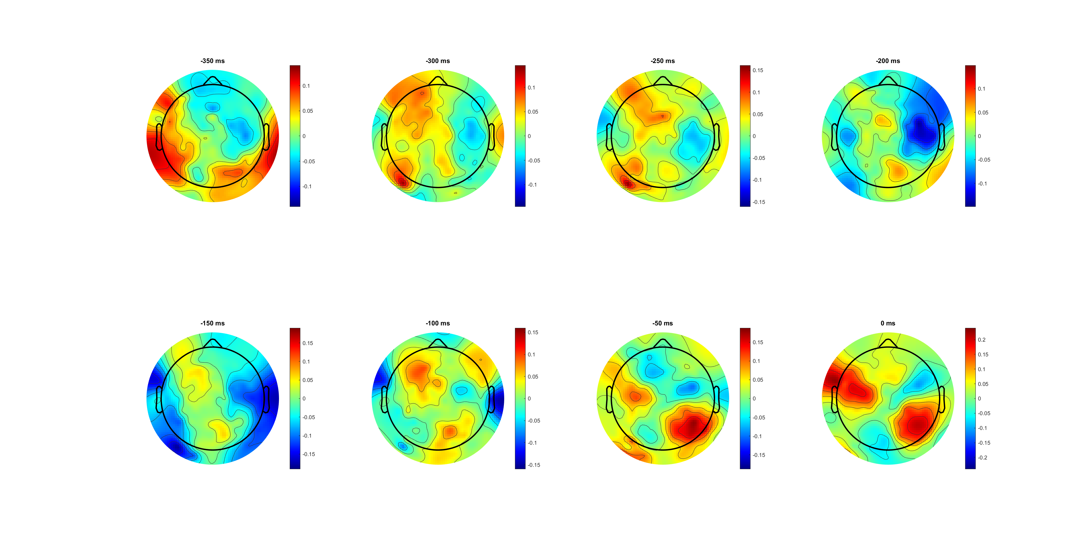
RL

Slide 6
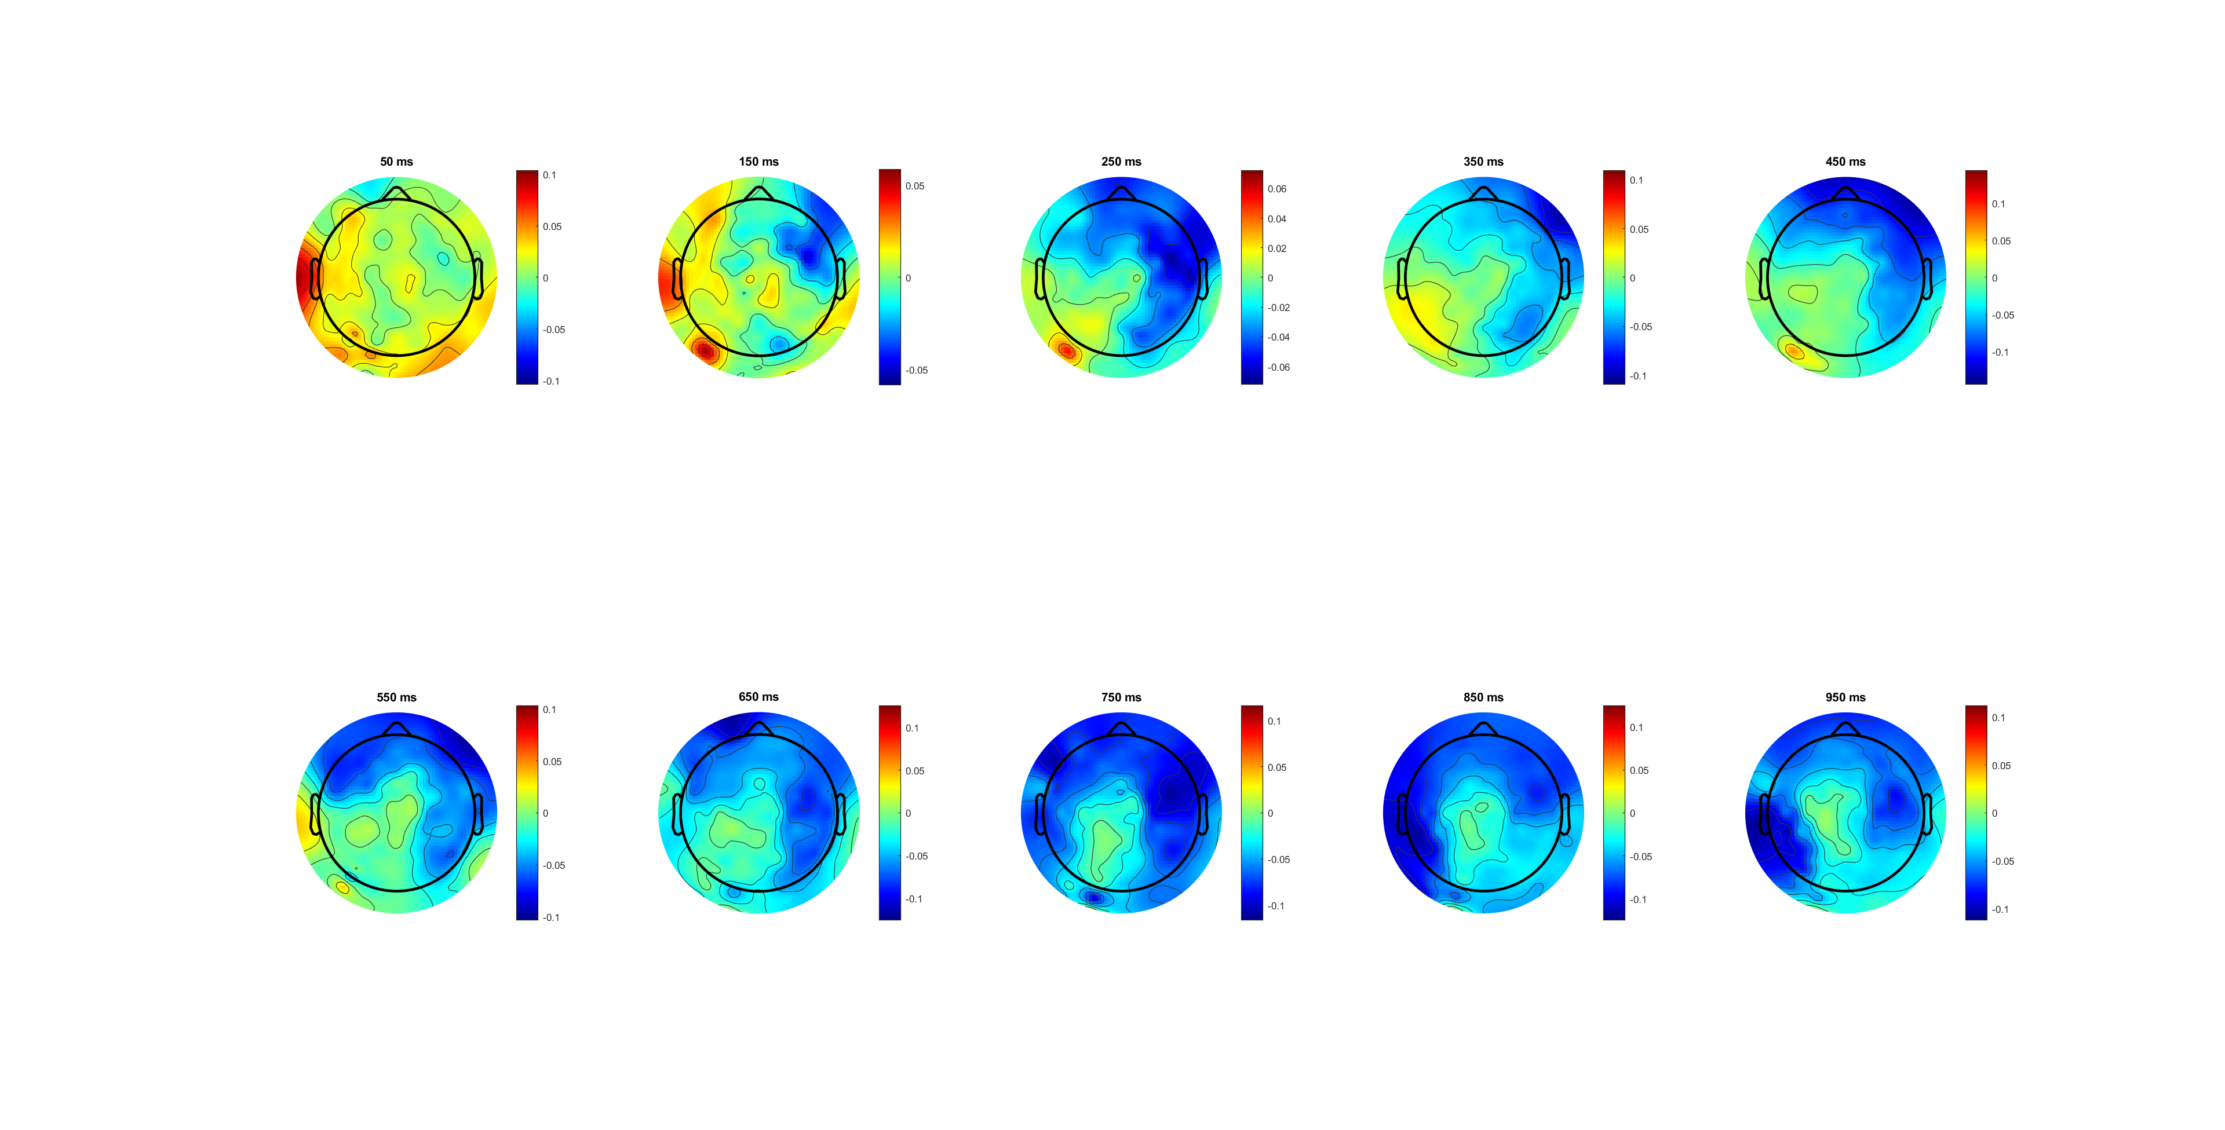
SL/iSL

Slide 7
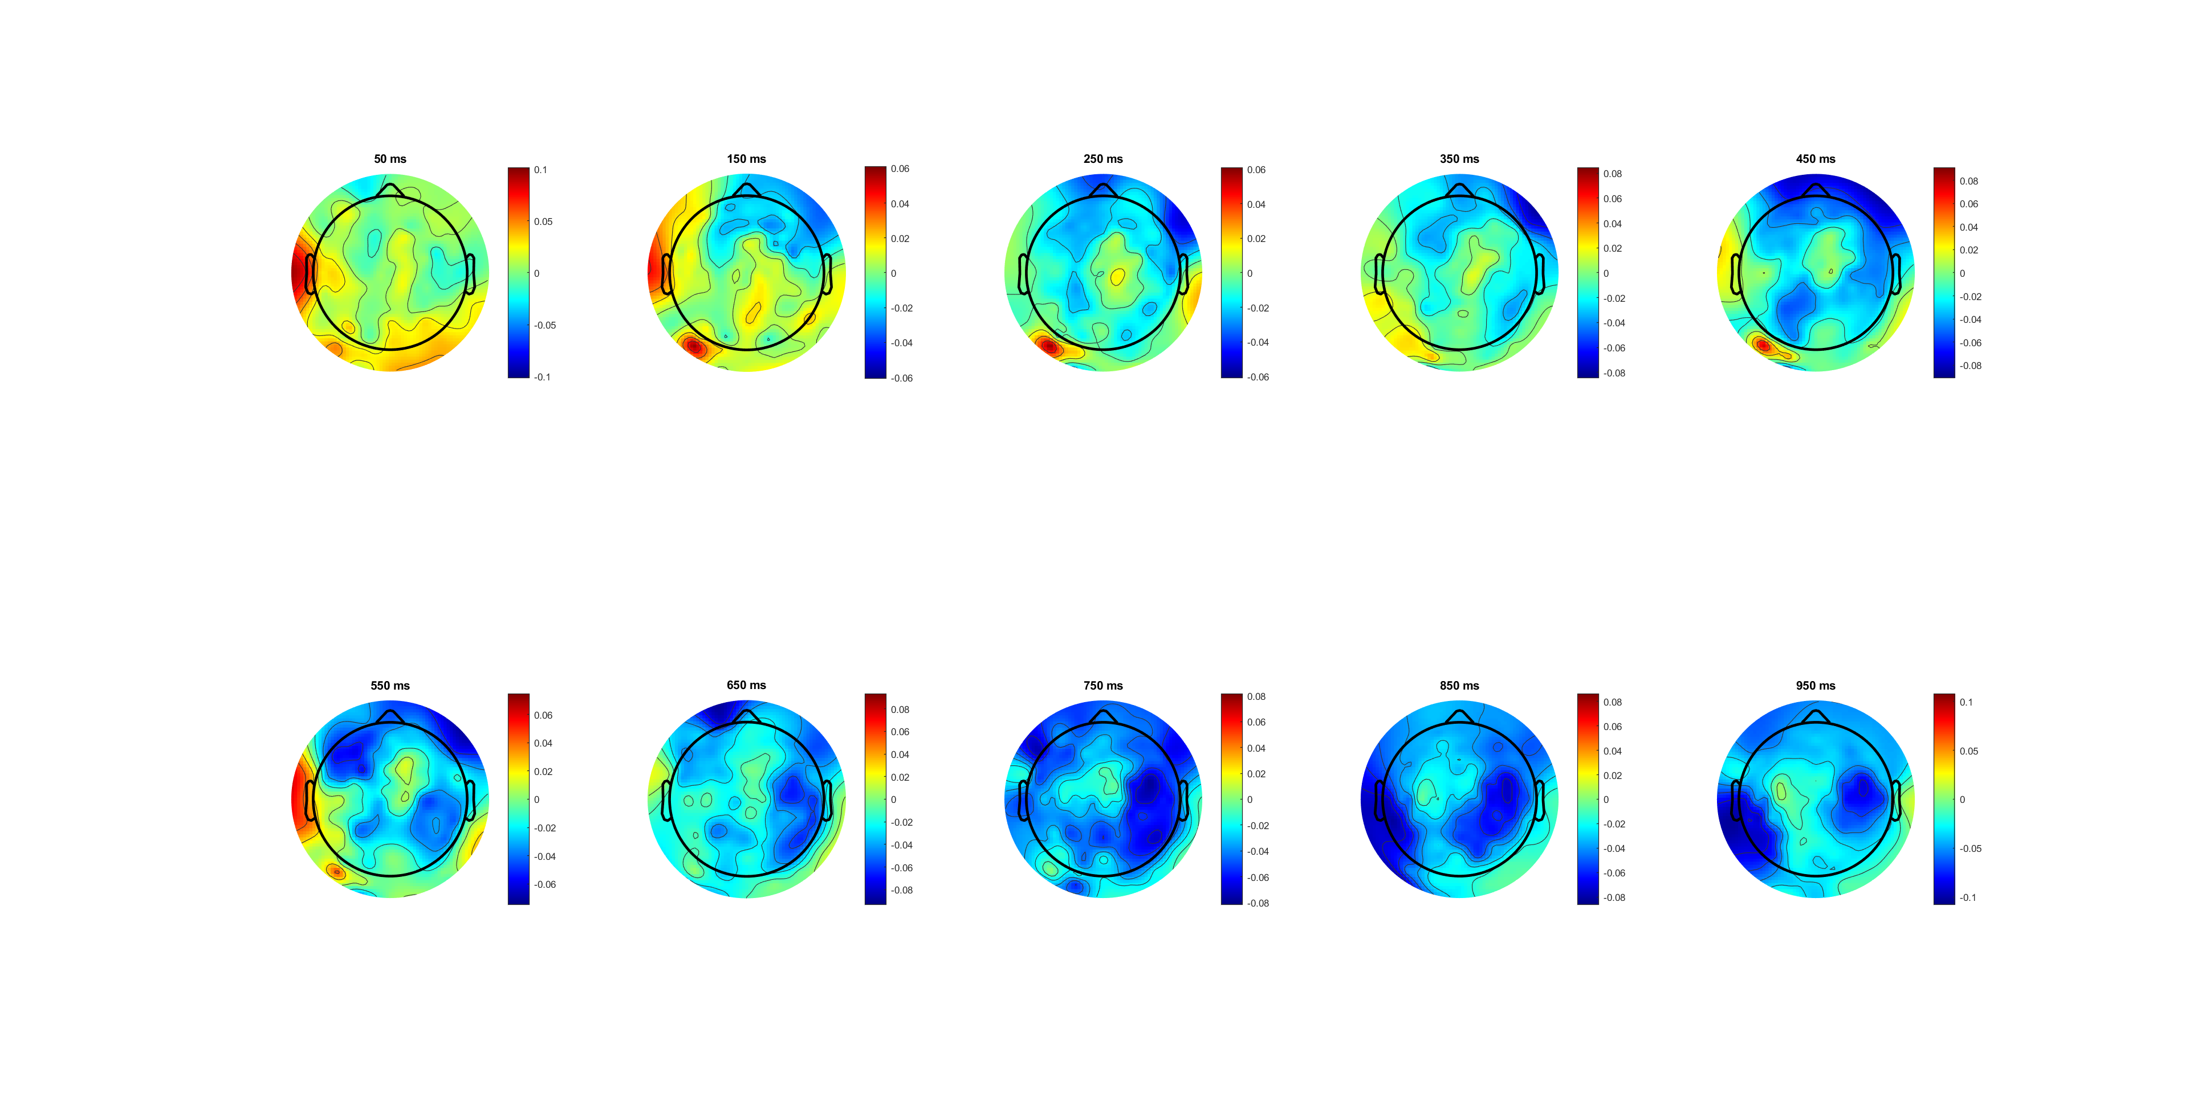
riSL

Slide 8
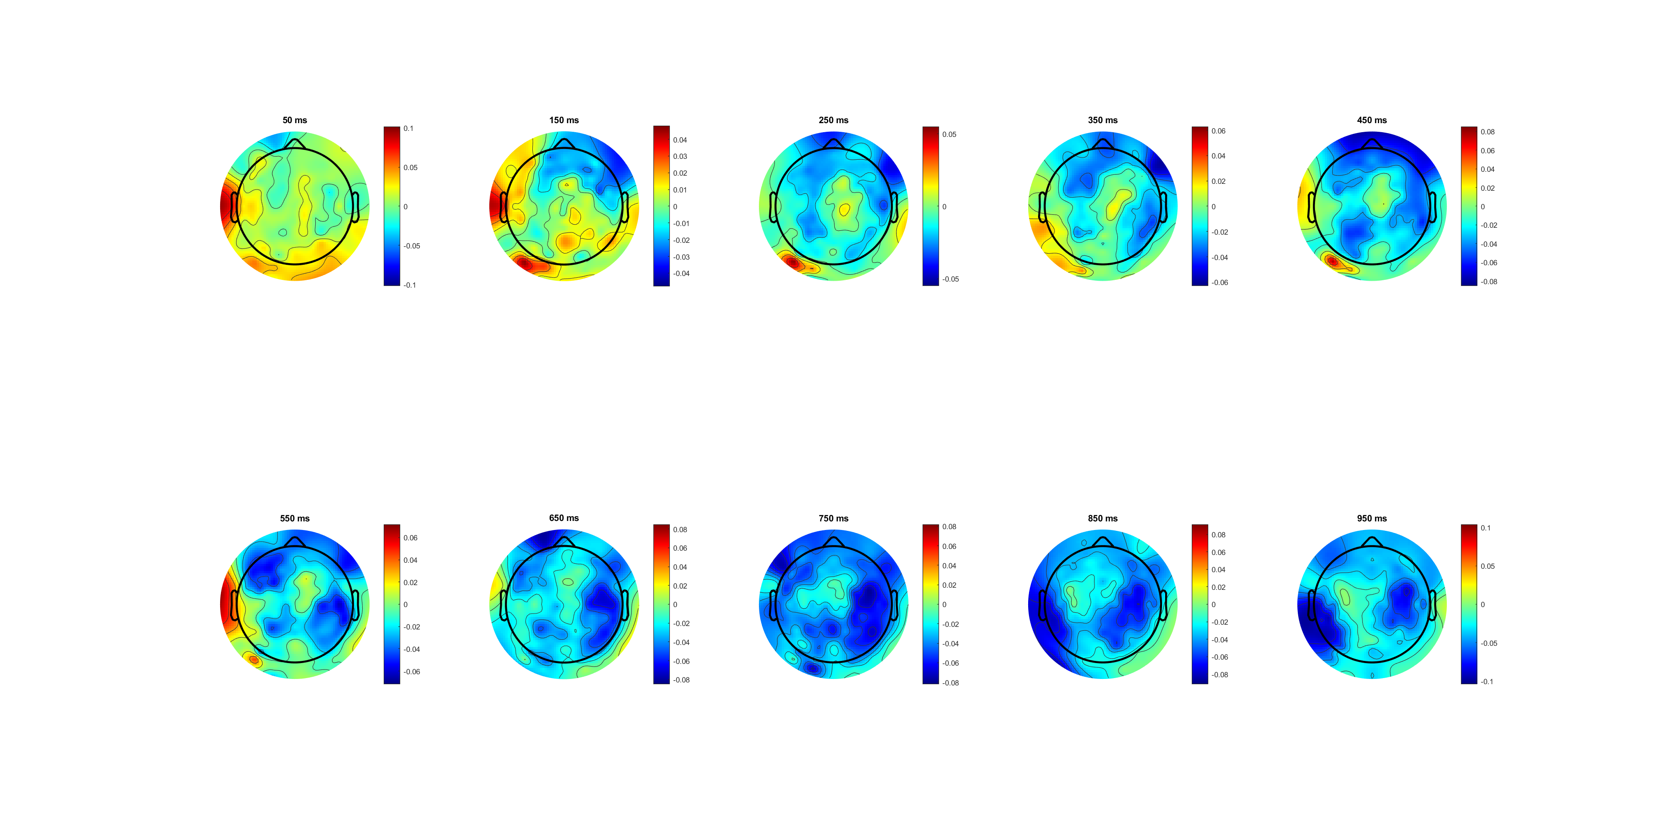
((a)bb_)cICAriSL

Slide 9
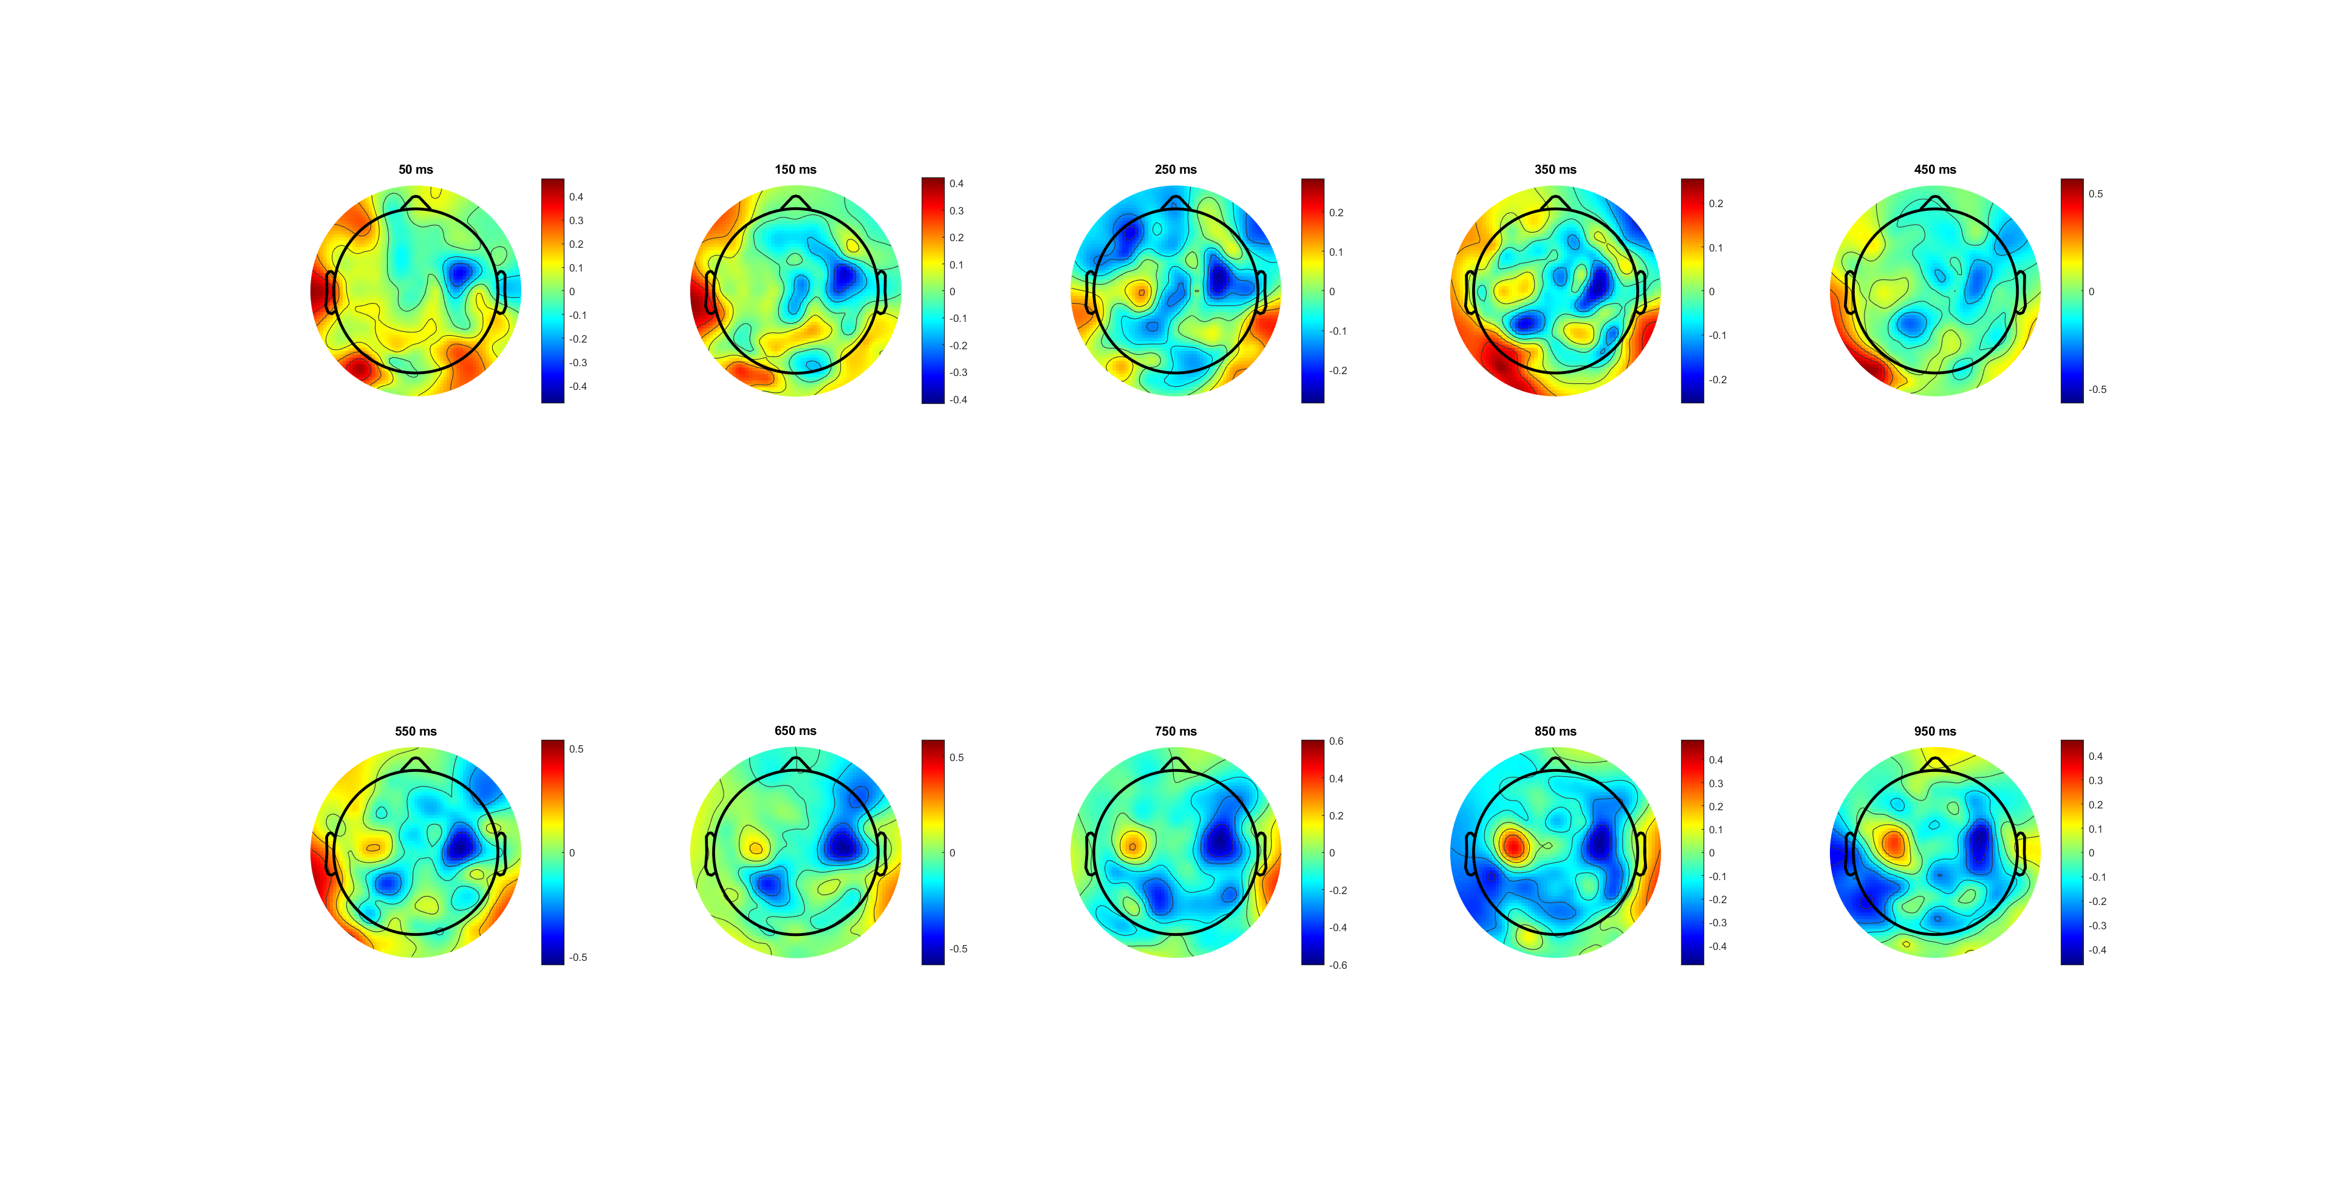
My pipeline (SL -300 1000) csd changed the amplitude and shape a lot? Diff amplitude compare to H

Slide 10
(C34; FC34; C34-;C34+) which one is better?

Slide 11
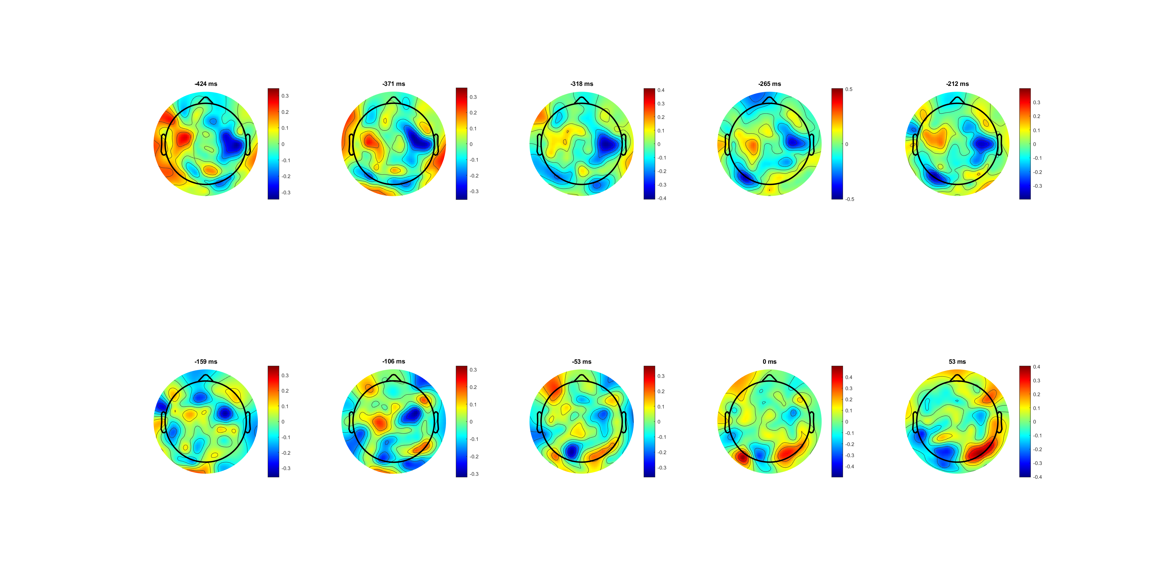

RL -400-100

Slide 12
(C34; FC34; C34-) which one is better?

Slide 14
My data P1-P6

Slide 15
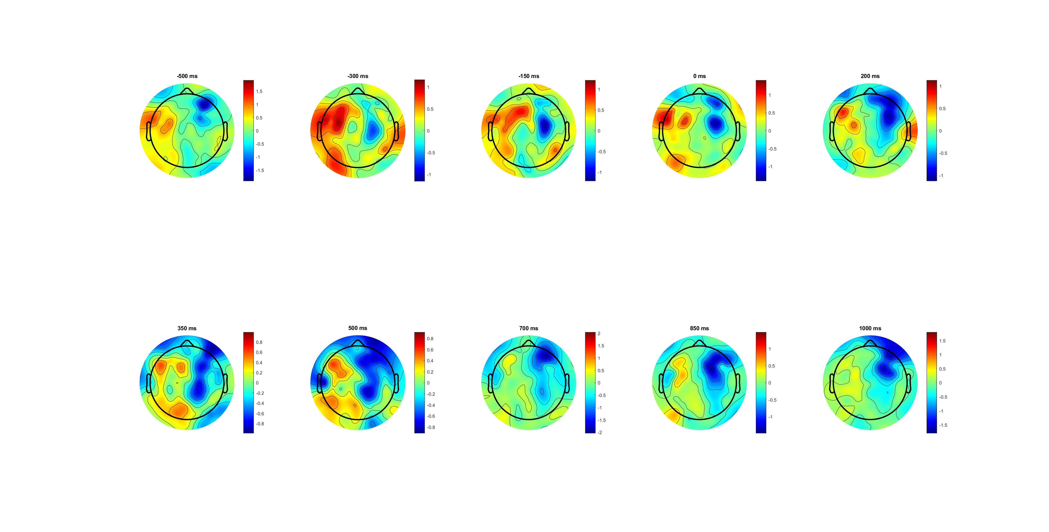
P6 (C34; FC34) Ts = [-800:50:2000];?? Drag problem
SL

Slide 16
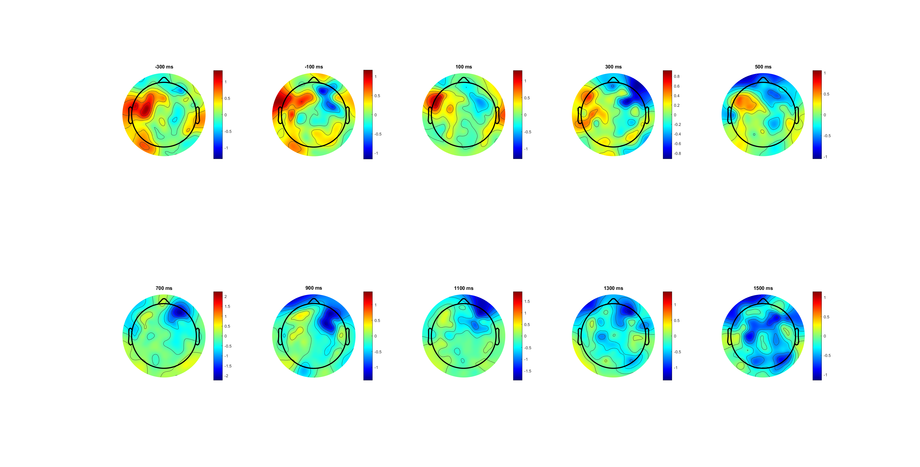
P6 (C34; FC34) Ts =[-300:50:1000];??
SL

Slide 17
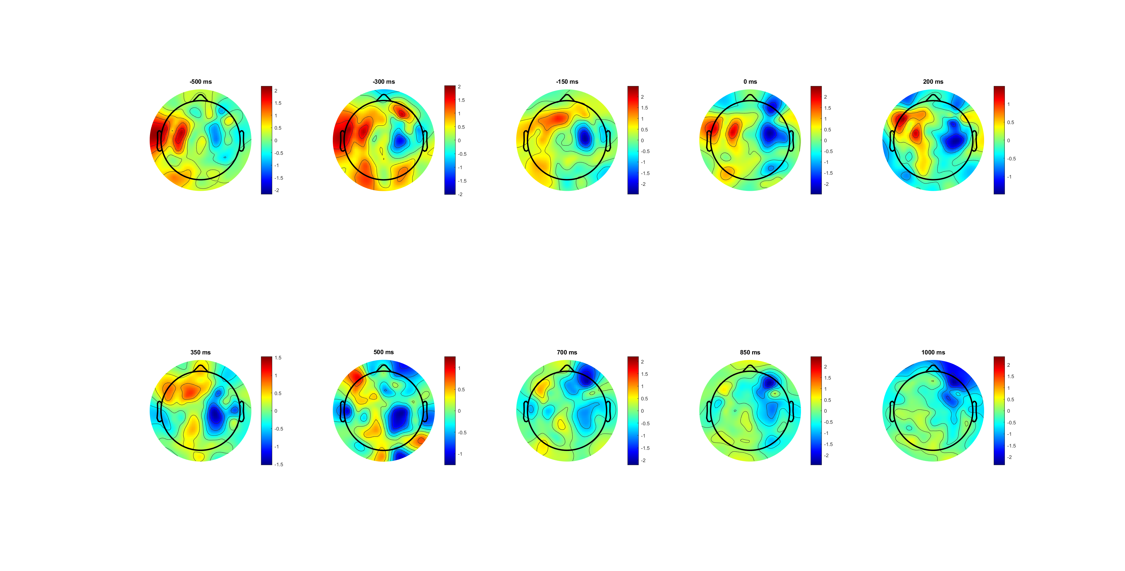
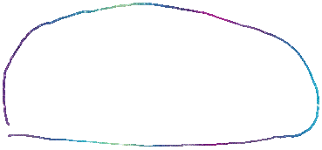
P6 FDI only (C34; C34+)
SL

Slide 18
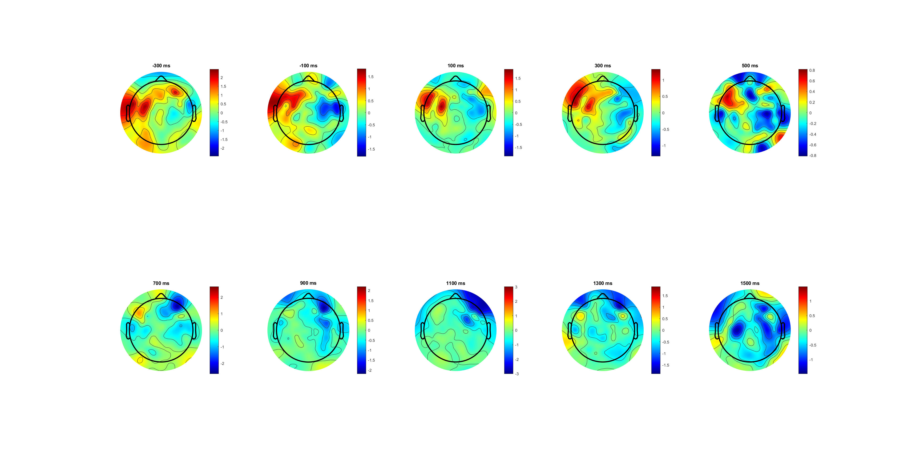
P6 FDI only (C34; C34+)
SL

Slide 19
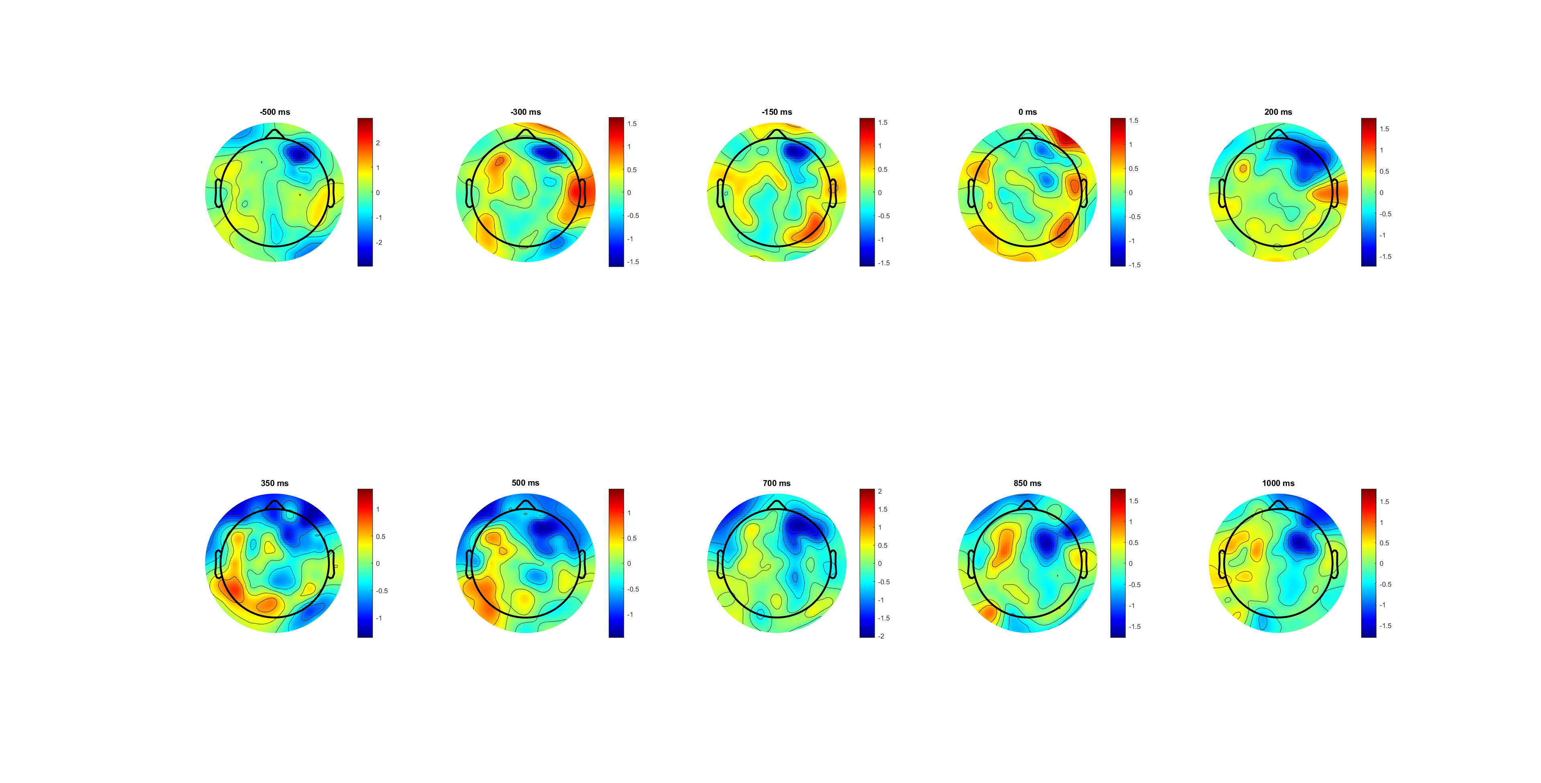
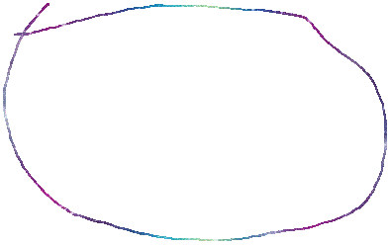
P6 BCP only (C34; C34- )
SL

Slide 20
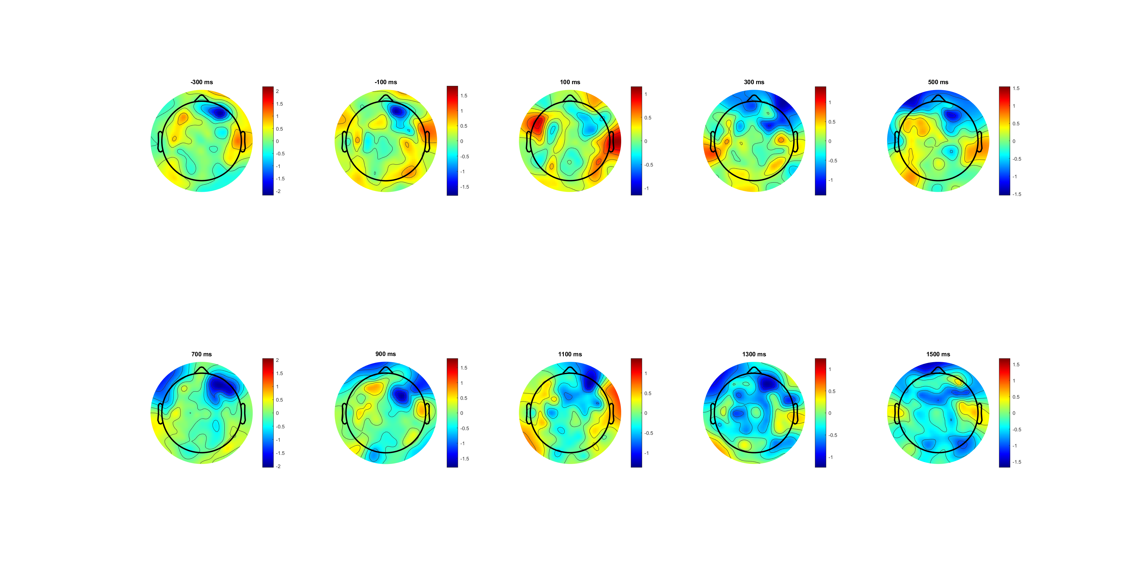
P6 BCP only (C34; C34- )
SL

Slide 21
P1-P5 no MB

